Slide 1


KGiSL Institute of Technology
(Approved by AICTE, New Delhi; Affiliated to Anna University, Chennai)
Recognized by UGC, Accredited by NBA (IT)
365, KGiSL Campus, Thudiyalur Road, Saravanampatti, Coimbatore – 641035.
Department of Artificial Intelligence and
Machine Learning
Name of the Faculty : ASWINI.C
Subject Code & Name : 24UAMP10 - MLOPS
Branch & Department : B.E CSE(AI&ML)
Year & Semester : III/V
Academic Year : 2026-2027

Slide 2
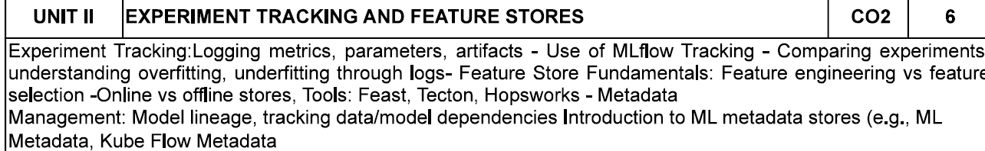

Slide 3
Experiment Tracking
Experiment Tracking is the process of recording and managing all information generated during machine learning experiments.
It records
Hyperparameters
Evaluation metrics
Model versions
Source code
Dataset versions
Training logs
Artifacts

Slide 4
Parameters
Parameters are the settings used before training the model.
Also called Hyperparameters.
Learning Rate = 0.01
Epochs = 100
Batch Size = 32
Max Depth = 5
Number of Trees = 100
Parameters control how the model learns.

Slide 5
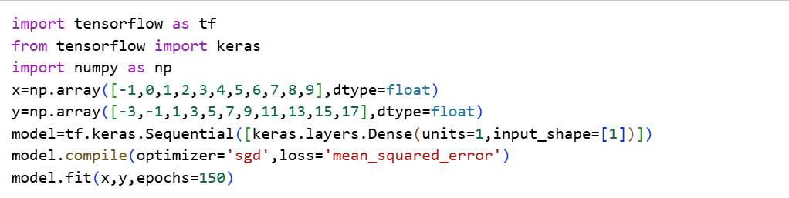

Slide 6
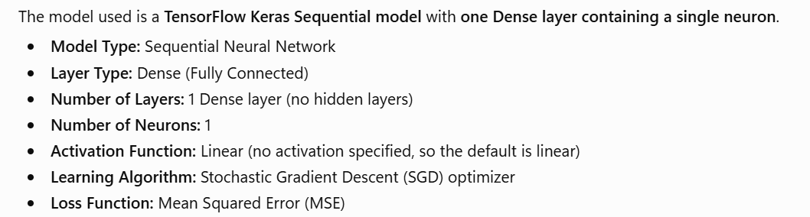

Slide 7
a=np.array([12])
print(model.predict([a]))
1/1 ━━━━━━━━━━━━━━━━━━━━ 0s 40ms/step Result: [[22.59902]]

Slide 8
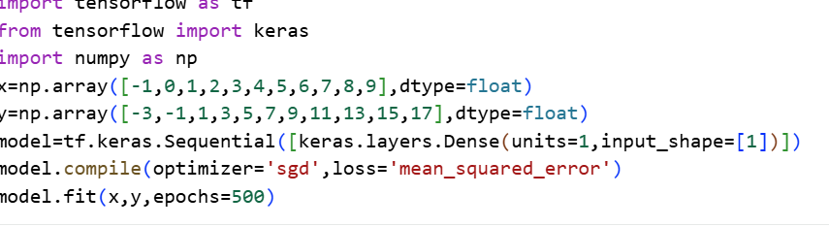

Slide 9
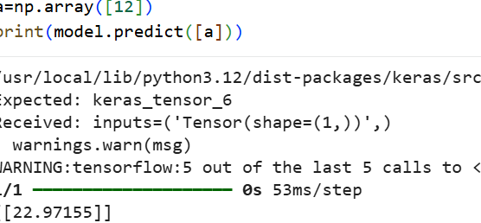

Slide 10
Example
Random Forest:
n_estimators = 100
max_depth = 10
random_state = 42

Slide 11
Metrics
Definition
Metrics measure the performance of the trained model.
Classification Metrics
Accuracy
Precision
Recall
F1 Score
ROC-AUC

Slide 12
Regression Metrics
MAE
MSE
RMSE
R² Score

Slide 13
Artifacts
Artifacts are files generated during an experiment that need to be stored for future reference.
Examples
Trained Model
Graphs
Confusion Matrix
ROC Curve
Dataset Snapshot
Feature Importance Plot
Prediction Results
Log Files

Slide 14
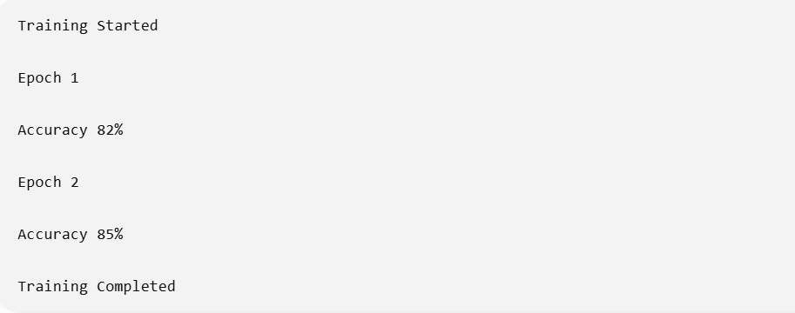
Logs
Logs record everything that happens during training.

Slide 15
MLflow
MLflow is an open-source platform used for managing the machine learning lifecycle.
It helps track:
Experiments
Parameters
Metrics
Artifacts
Models

Slide 16
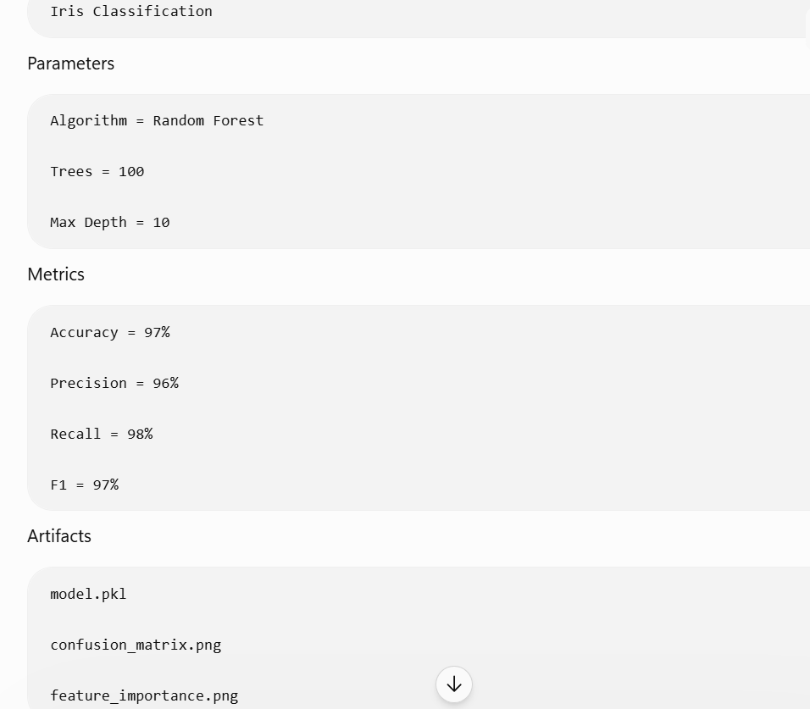

Slide 17
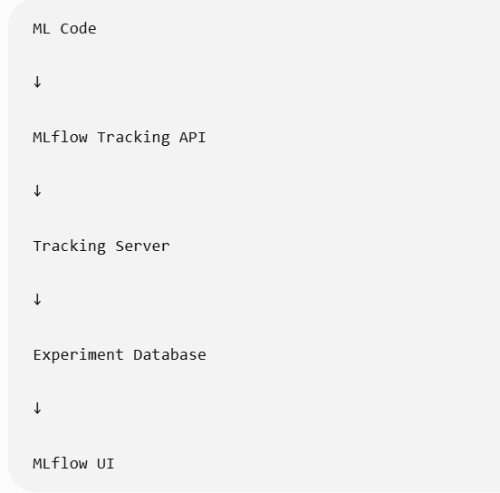
Mlflow Architecture

Slide 18
Benefits of Experiment Tracking
Improves reproducibility.
Saves all experiments.
Easy model comparison.
Supports teamwork.
Simplifies debugging.
Maintains experiment history.
Helps identify the best-performing model.
Facilitates deployment decisions.

Slide 19
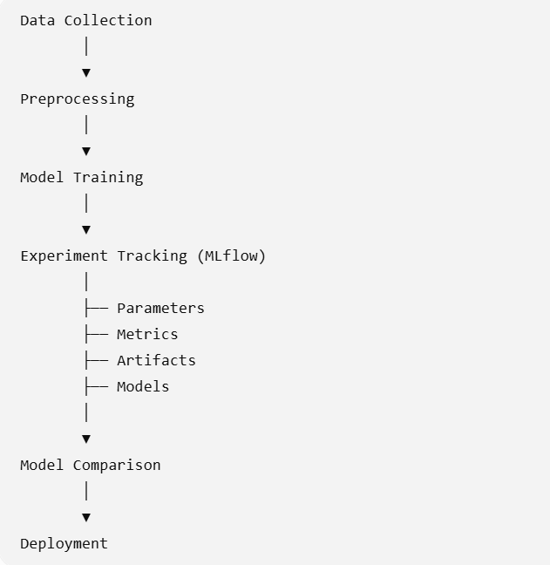
Experiment Tracking in the MLOps Pipeline

Slide 20
Experiment Comparison
Evaluating multiple machine learning experiments based on their parameters, metrics, and artifacts to identify the best-performing model.
Experiment | Algorithm | Accuracy
Run 1 | Decision Tree | 82%
Run 2 | Random Forest | 90%
Run 3 | XGBoost | 95%

Slide 21
Experiment Comparison
Run | Algorithm | Accuracy | Training Time | Best?
Run 1 | Logistic Regression | 87% | 2 sec | No
Run 2 | Decision Tree | 91% | 4 sec | Good
Run 3 | Random Forest | 95% | 12 sec | Better
Run 4 | XGBoost | 96% | 55 sec | Depends

Slide 22
Overfitting and Underfitting
Training Accuracy: 99%
Testing Accuracy : 65%
Because of Overfitting
Training Accuracy :60%
Testing Accuracy :58%
Because of Underfitting

Slide 23
Underfitting
A model that performs poorly on both training and testing data.
It fails to learn patterns.
Training Accuracy: 58%
Testing Accuracy: 56%
Characteristics
High bias
Low variance
Poor predictions
Simple model

Slide 24
Causes of Underfitting
Too few features
Insufficient training
Very simple algorithm
Incorrect parameters
Solutions
Increase
Features
Training time
Model complexity

Slide 25
Overfitting
A model that memorizes training data but performs poorly on unseen data.
Training Accuracy: 99%
Testing Accuracy: 72%

Slide 26
Characteristics
Low bias
High variance
Poor generalization

Slide 27
Causes
Too many features
Very deep trees
Too many epochs
Small dataset
Solutions
More data
Regularization
Early stopping
Reduce complexity
Cross validation
Pruning

Slide 28
Good Fit
Training Accuracy: 95%
Testing Accuracy: 94%
Bias | Variance
Error due to overly simple model | Error due to excessive complexity
Causes Underfitting | Causes Overfitting
Low accuracy | High training accuracy but poor testing accuracy

Slide 29
Detecting Overfitting,Underfitting,Goodfit
Run 1
Train Accuracy =99
Test Accuracy =72

Slide 30
Run 2:
train_accuracy=61
test_accuracy=59
Run 3:
train_accuracy=95
test_accuracy=94

Slide 31
Bias
Error caused by a model making overly simple assumptions and failing to learn the actual patterns in the data.
A model with high bias does not learn enough from the training data.
Practical example:
Suppose we want to predict student marks using:
Study hours
Attendance
Previous marks
Assignment score

Slide 32
Simple student example
Assume a student studies only one chapter for an examination.
The student does not understand the complete syllabus.
Therefore:
Performance in practice tests → Poor
Performance in the final examination → Poor
This is similar to a high-bias model.
The model has learned too little.

Slide 33
Variance
Variance represents how sensitive a model is to changes in the training data.
A high-variance model learns the training data too closely.
Actual patterns
Noise
Random variations
Unnecessary details
It performs very well on the training data but poorly on unseen data.

Slide 34
Simple student example
A student memorizes all answers from one previous-year question paper.
The student scores:
Same practice paper = 100%
New question paper = 60%
The student memorized the old questions but did not understand the concepts.
This is similar to a high-variance model.

Slide 35
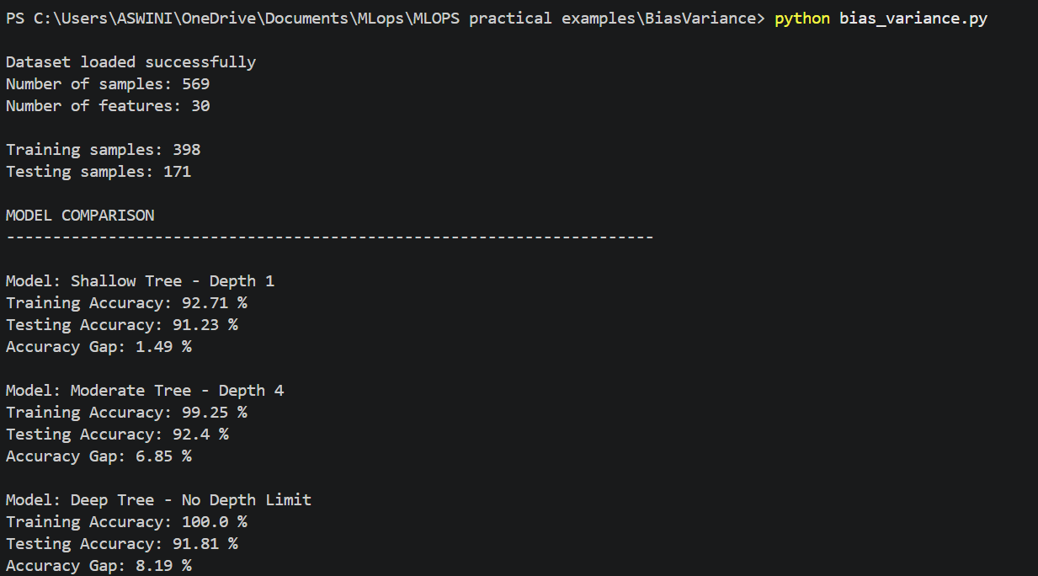

Slide 36
Depth | Training Accuracy | Testing Accuracy | Accuracy Gap | Interpretation
1 | 92.71% | 91.23% | 1.49% | Simple model; low gap and good generalization
4 | 99.25% | 92.40% | 6.85% | Best testing accuracy; some overfitting
None | 100.00% | 91.81% | 8.19% | Highest overfitting among the three

Slide 37
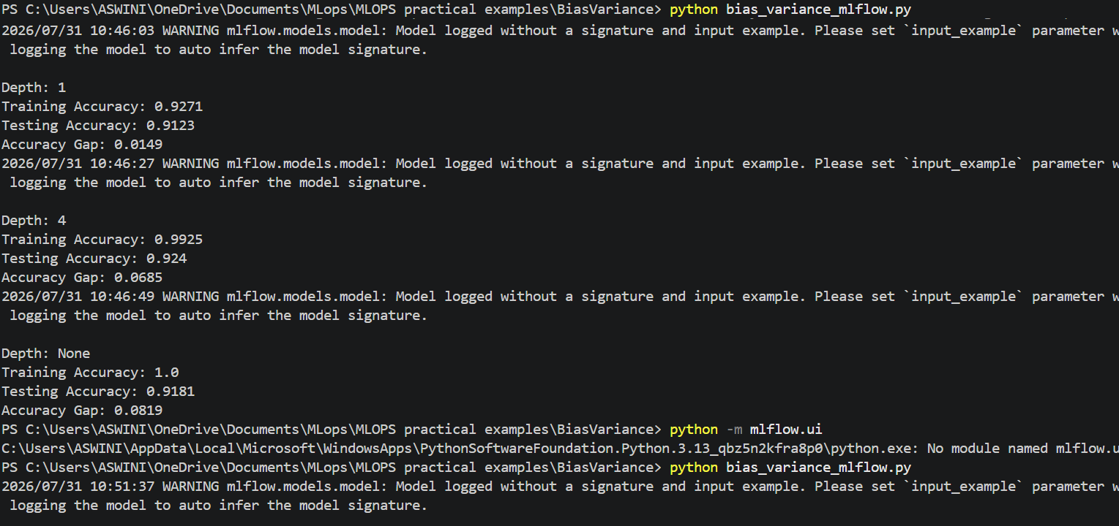

Slide 38
Feature Store Fundamentals
Feature:
Individual measurable property or input variable used by a machine learning model to make predictions.
Feature also called as:
Input variables
Predictor variables
Independent variables
Attributes
Ex: Student performance prediction system

Slide 39
Student performance prediction system
Attendance | Study Hours | Previous Marks | Assignment Score | Final Result
90 | 3 | 75 | 80 | Pass
60 | 1 | 45 | 50 | Fail
85 | 4 | 82 | 88 | Pass

Slide 40
Input features
Attendance
Study Hours
Previous Marks
Assignment Score
Target variable
Final Result

Slide 41
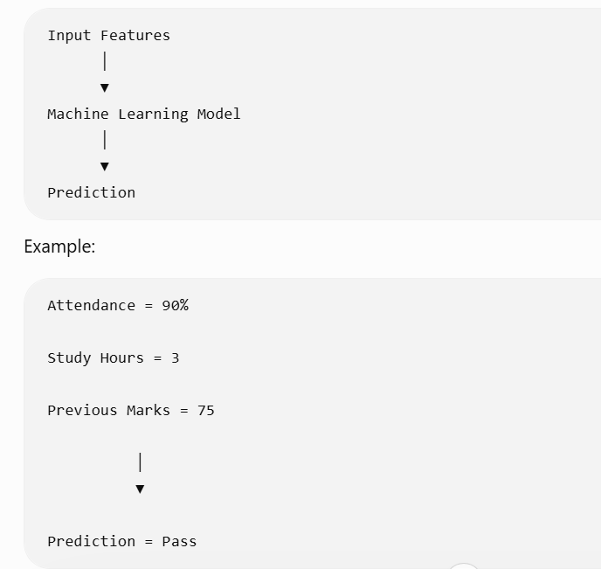
Feature Representation

Slide 42
Feature Engineering
Process of creating, transforming, extracting, or modifying features from raw data to improve machine learning model performance.
Converts raw data into useful information that can be understood by an ML model.

Slide 43
Date of Purchase | Sales
2026-01-15 | 500
2026-06-20 | 800
2026-12-10 | 1000
Using feature engineering, we can create:
Date | Month | Day | Quarter | Weekend
2026-01-15 | 1 | 15 | Q1 | No
2026-06-20 | 6 | 20 | Q2 | Yes
2026-12-10 | 12 | 10 | Q4 | No

Slide 44
Month is a new feature.
Day is a new feature.
Quarter is a new feature.
Weekend is a new feature.
Common Feature Engineering Techniques:
1. Handling Missing Values
Age | Income
25 | 50,000
Missing | 60,000
30 | 70,000

Slide 45
The missing age can be replaced using:
Mean
Median
Mode
A constant value
When a dataset contains missing values, we can replace the missing values using mean, median, or mode. This process is called imputation.
The choice depends mainly on:
Whether the feature is numerical or categorical
Whether the data contains outliers
Whether the data distribution is symmetric or skewed

Slide 46
Mean Imputation
The mean is the average of all available numerical values.
Formula:
Mean = Sum of all values / Number of values
Example
Consider the following student marks:
70, 75, Missing, 80, 85
Mean = (70 + 75 + 80 + 85) / 4
Mean = 310 / 4
Mean = 77.5
Replace the missing value with:
70, 75, 77.5, 80, 85

Slide 47
Use mean imputation when:
The feature is numerical
The data is approximately normally distributed
The data does not contain significant outliers
The values are reasonably balanced around the center
Student Marks: 65, 70, 72, Missing, 75, 78
The values are close to one another and there are no extreme values. Therefore, mean is suitable.
Avoid mean when the data contains outliers.

Slide 48
Example:
Salary:
25,000
30,000
35,000
40,000
5,00,000
Missing
The value 5,00,000 is an extreme value or outlier.
In this case, use the median.

Slide 49
Median Imputation
The median is the middle value after arranging the data in ascending or descending order.
Example 1: Odd number of values
10, 20, 30, 40, 50
The middle value is:
Median = 30
Example 2: Even number of values
10, 20, 30, 40
There are two middle values:
20 and 30
Median = (20 + 30) / 2=25

Slide 50
Missing-value example
Consider the following salaries:
25,000 30,000 35,000 40,000 5,00,000 Missing
Missing=?
When should we use median?
Use median imputation when:
The feature is numerical
The data contains outliers
The data is skewed
The mean is affected by extreme values

Slide 51
Mode Imputation
The mode is the value that occurs most frequently.
Example
Consider the following department values:
    CSE
    CSE
    AIML
    CSE
    IT
    Missing
The most frequently occurring value is:
CSE
Replace the missing value with: CSE

Slide 52
Use mode imputation when:
The feature is categorical
The feature contains labels or categories
The most frequently occurring category is a reasonable replacement
Payment Method:
UPI
Card
UPI
Cash
UPI
Missing = ?

Slide 53
Skewed Data
Data in which the values are not distributed evenly or symmetrically around the center.
Most values are concentrated on one side, while a few extreme values on the other side.
Positively Skewed Data (Right-Skewed)
Negatively Skewed Data (Left-Skewed)

Slide 54
Positively Skewed Data
In a positively skewed distribution, most values are small or medium, but a few very large values create a long tail on the right side.
Example: Employee salaries
₹20,000
₹25,000
₹30,000
₹35,000
₹40,000
₹5,00,000
For positively skewed numerical data, we generally prefer:
MEDIAN

Slide 55
Negatively Skewed Data (Left-Skewed)
In a negatively skewed distribution, most values are high, but a few very small values create a long tail on the left side.
Example: Marks in an easy examination
20 75 80 85 90 95 98
For negatively skewed numerical data, the median is often preferred

Slide 56
Data type | Example values | Shape | Suitable missing-value method
Symmetric | 40, 45, 50, 55, 60 | Balanced | Mean
Positive skew | 20, 25, 30, 35, 5,00,000 | Long right tail | Median
Negative skew | 20, 75, 80, 85, 90, 95 | Long left tail | Median

Slide 57
Suppose salary data is:
₹20,000
₹25,000
₹30,000
₹35,000
₹40,000
₹5,00,000
Missing
Using mean
Mean= (20,000 + 25,000 + 30,000 + 35,000 + 40,000 + 5,00,000) / 6
= ₹1,08,333
The mean is ₹1,08,333, which is much higher than the salary of most employees.

Slide 58
Using median
Arrange the values:
₹20,000
₹25,000
₹30,000
₹35,000
₹40,000
₹5,00,000
The two middle values are ₹30,000 and ₹35,000.
Median = (₹30,000 + ₹35,000) / 2 = ₹32,500
₹32,500 is more representative of the typical salary.

Slide 59
Encoding Categorical Data:
Machine learning algorithms generally require numerical input.
Convert it into numerical form.
Label encoding
Department
CSE
AIML
IT
Department | Encoded Value
AIML | 0
CSE | 1
IT | 2

Slide 60
from sklearn.preprocessing import LabelEncoder
encoder = LabelEncoder()
df["Department_encoded"] = encoder.fit_transform(
df["Department"]
)

Slide 61
Scaling Numerical Features
Age | Annual Income
25 | 50000
30 | 80000
The values have different ranges.
Feature scaling converts values to comparable ranges.

Slide 62
from sklearn.preprocessing import StandardScaler
scaler = StandardScaler()
X_scaled = scaler.fit_transform(X)

Slide 63

Creating New Features
Total Marks | Number of Subjects
450 | 5
360 | 5
Create a new feature:
$$\text{Average Marks}=\frac{\text{Total Marks}}{\text{Number of Subjects}}$$

Slide 64
df["Average_Marks"] = (
df["Total_Marks"] /
df["Number_of_Subjects"]
)
Extracting Features from Date:
df["Date"] = pd.to_datetime(df["Date"])
df["Year"] = df["Date"].dt.year
df["Month"] = df["Date"].dt.month
df["Day"] = df["Date"].dt.day
df["Day_of_Week"] = df["Date"].dt.dayofweek

Slide 65
Text Feature Engineering
Text cannot be directly given to most machine learning models.
"This product is excellent“
Convert the text into numerical features using:
Bag of Words
TF-IDF
Word embeddings

Slide 66
from sklearn.feature_extraction.text import TfidfVectorizer
vectorizer = TfidfVectorizer()
X = vectorizer.fit_transform(text_data)

Slide 67
Feature Selection
Process of selecting the most relevant and useful features from the available features and removing unnecessary or irrelevant features.
Feature selection does not create new features.
It selects useful features from the existing set.

Slide 68
Age | Height | Weight | Student ID | Study Hours | Attendance | Result
20 | 165 | 60 | 101 | 4 | 90 | Pass
For predicting the student result:
Useful features may be:
Study Hours
Attendance
Less useful or irrelevant features may be:
Student ID
Height

Slide 69
Why is Feature Selection Needed
Remove irrelevant features.
Reduce model complexity.
Reduce training time.
Reduce memory usage.
Reduce overfitting.
Improve model interpretability.
Improve model performance in some cases.

Slide 70
Feature Selection Methods
Filter methods
Wrapper methods
Embedded methods
Filter Methods:
Filter methods select features using statistical measures.
Examples:
Correlation
Chi-square test
ANOVA
Mutual information

Slide 71
from sklearn.feature_selection import SelectKBest
from sklearn.feature_selection import f_classif
selector = SelectKBest(
score_func=f_classif,
k=2
)
X_selected = selector.fit_transform(X, y)

Slide 72
Wrapper Methods
Wrapper methods evaluate different feature combinations using a machine learning model.
Examples:
Forward Selection
Backward Elimination
Recursive Feature Elimination (RFE)

Slide 73
Embedded Methods
Embedded methods perform feature selection during model training.
Examples:
Lasso Regression
Decision Tree
Random Forest
Decision trees can estimate feature importance.
model.feature_importances_

Slide 74
Feature Engineering | Feature Selection
Creates or transforms features | Selects useful existing features
May increase the number of features | Usually reduces the number of features
Converts raw data into meaningful features | Removes irrelevant or redundant features
Example: Extract month from date | Example: Select attendance and study hours
Improves feature representation | Reduces feature complexity
Performed during data preparation | Performed before or during model training

Slide 75
Feature Store
A Feature Store is a centralized system used to create, store, manage, version, discover, share, and serve machine learning features.
A feature store helps ensure that the same feature definitions are used during:
Model training
Model validation
Model deployment
Real-time prediction

Slide 76
Why Do We Need a Feature Store?
Average Monthly Purchase
The feature is calculated using:
Total Purchase Amount
─────────────────────
Number of Months
The model is trained using this calculation.
During deployment, the application calculates the feature differently.
This creates inconsistent results.
This problem is called training-serving skew.

Slide 77
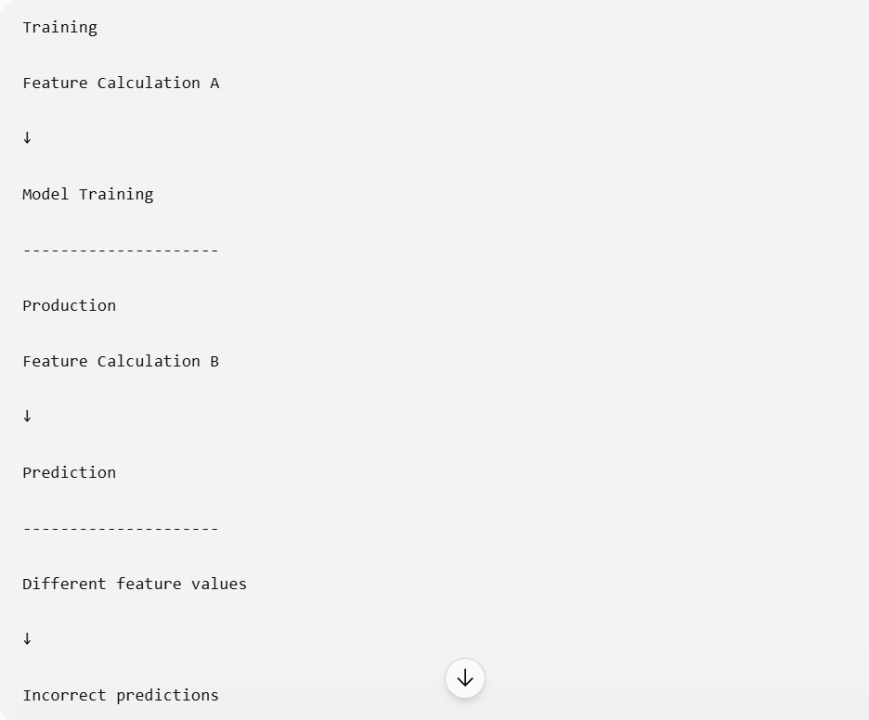
Training-serving skew

Slide 78
Benefits of a Feature Store
Centralized feature management
Feature reuse
Consistent feature definitions
Reduced duplicate work
Better collaboration
Feature versioning
Faster model development
Reduced training-serving skew
Supports batch and real-time features

Slide 79
Main Components of a Feature Store
Feature Registry - Stores information about features.
Example:
Feature Name:
average_marks
Data Type:
float
Description:
Average marks obtained by a student
Version:
1.0

Slide 80
2. Feature Definitions - Defines how a feature is created.
Example:
average_marks= total_marks/number_of_subjects
3. Offline Feature Store
Stores historical feature data used for model training.
4 Online Feature Store
Stores the latest feature values used for real-time prediction.

Slide 81
5. Feature Metadata:
Stores information such as:
Feature name
Data type
Description
Owner
Creation date
Version
Source
Update frequency

Slide 82
Offline Feature Store
An Offline Feature Store stores large volumes of historical feature data and is mainly used for:
Model training
Batch processing
Historical analysis
Feature generation

Slide 83
Example
Consider student attendance data.
This historical information can be stored in an offline feature store.
The model can use the complete history for training.
The model can use the complete history for training.
Student ID | Date | Attendance | Study Hours
101 | 2026-01-01 | 90 | 3
101 | 2026-02-01 | 92 | 4
101 | 2026-03-01 | 95 | 5
102 | 2026-01-01 | 70 | 1

Slide 84
Characteristics
Stores historical data.
Handles large datasets.
Supports batch processing.
Optimized for high storage capacity.
Used during model training.
Query response may take seconds or minutes.

Slide 85
Online Feature Store
An Online Feature Store stores the latest feature values and provides fast access for real-time model predictions.
Example
A student prediction application receives:
Student ID = 101
The application immediately requests:
Current Attendance = 95%
Current Study Hours = 5
Current Average Marks = 82

Slide 86
Characteristics
Stores recent or latest feature values.
Supports real-time prediction.
Provides low-latency access.
Optimized for fast retrieval.
Usually stores a smaller amount of data than an offline store.
Often uses key-value access.

Slide 87
Online vs Offline Feature Store
Feature | Offline Store | Online Store
Main purpose | Model training | Real-time prediction
Data type | Historical data | Latest feature values
Data volume | Very large | Relatively smaller
Processing | Batch processing | Real-time processing
Access speed | Seconds or minutes | Milliseconds
Storage | Data lake or warehouse | Fast database or key-value store
Used by | Data scientists | Deployed applications
Example | Historical attendance data | Current attendance

